Slide 1
Keyrock and API Umbrella for Data Spaces
Álvaro Arranz
Co-founder and CEO
FICODES
aarranz@ficodes.com

Slide 2
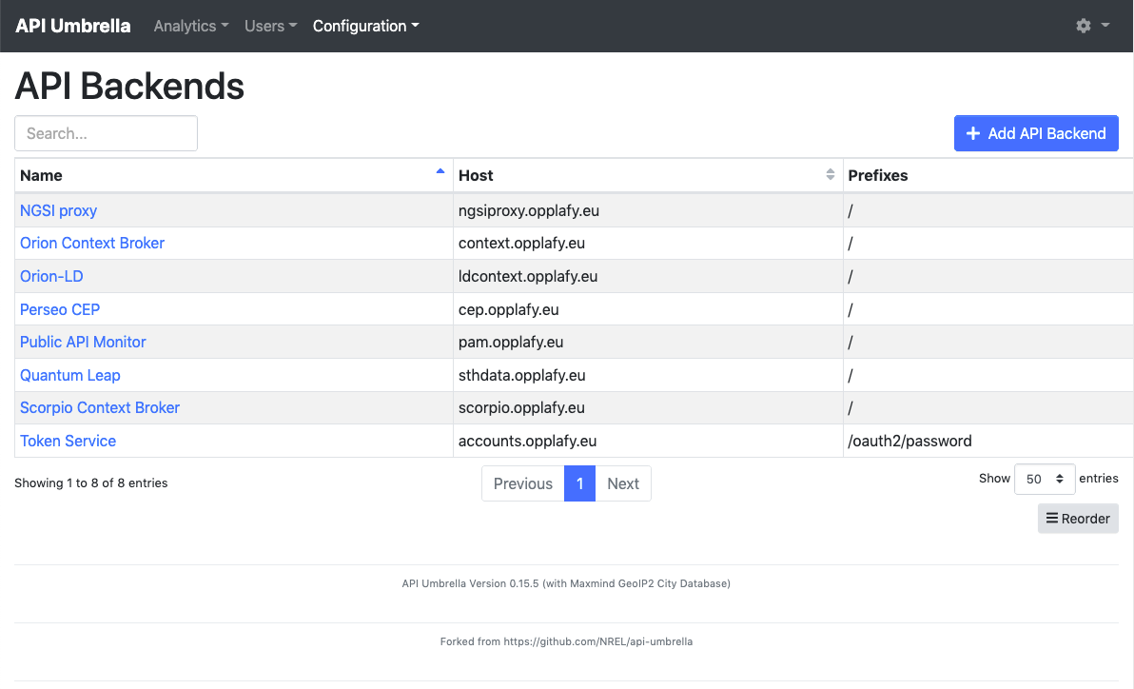
API Umbrella
Implements PEP and PDP features
Initially developed by the US National Renewable Energy Laboratory (NREL)
Adopted by FIWARE and enhanced with new features and security protocols
Supports securing backend (API) and frontend (Website) services, and can be used as a reverse proxy

Slide 3
API Umbrella
Support for different authentication and authorization protocols
Local users and API Keys (Implemented by NREL)
Integration with Keyrock (Implemented by FIWARE)
Requests made with OAuth2 bearer tokens or JSON Web Tokens
Support for Application roles
Support for i4Trust AR policy
Integration with Keycloak (Implemented by FIWARE)
Requests made with JSON Web Tokens
Support for realm roles and client roles

Slide 4
API Umbrella
API Backend
API services protected by API Umbrella
Redirection is configured using a frontend host and path rewritten to a backend host and path.
Settings can be applied to the whole backend service:
Authentication
Authorization: required roles to access
Headers and parameters to be injected in backend request
Rate limiting
Fine grain policies can be created using sub-url settings:
Matched with HTTP method + URL regex + required headers (Useful with FIWARE services)
Settings can be overridden for the sub-url

Slide 5
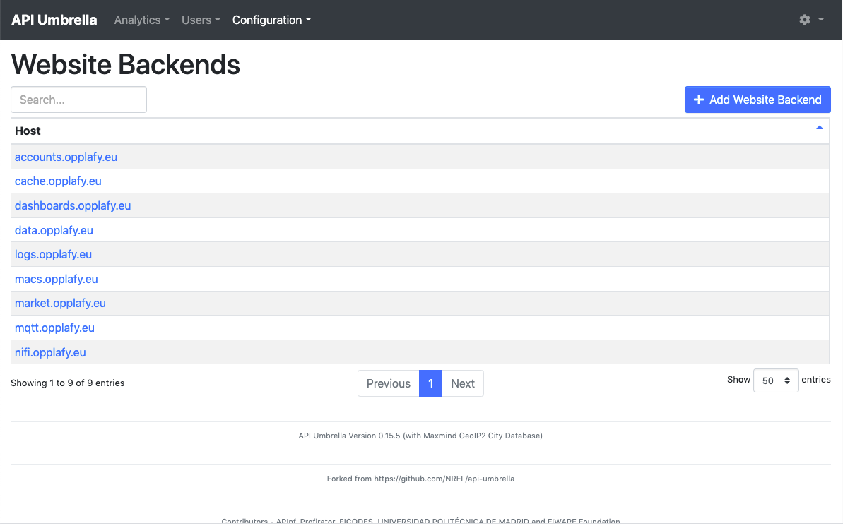
API Umbrella
Website backend
Uses the built-in NGINX server to create a reverse proxy
Frontend host and protocol are matched with the internal server and port.

Slide 6
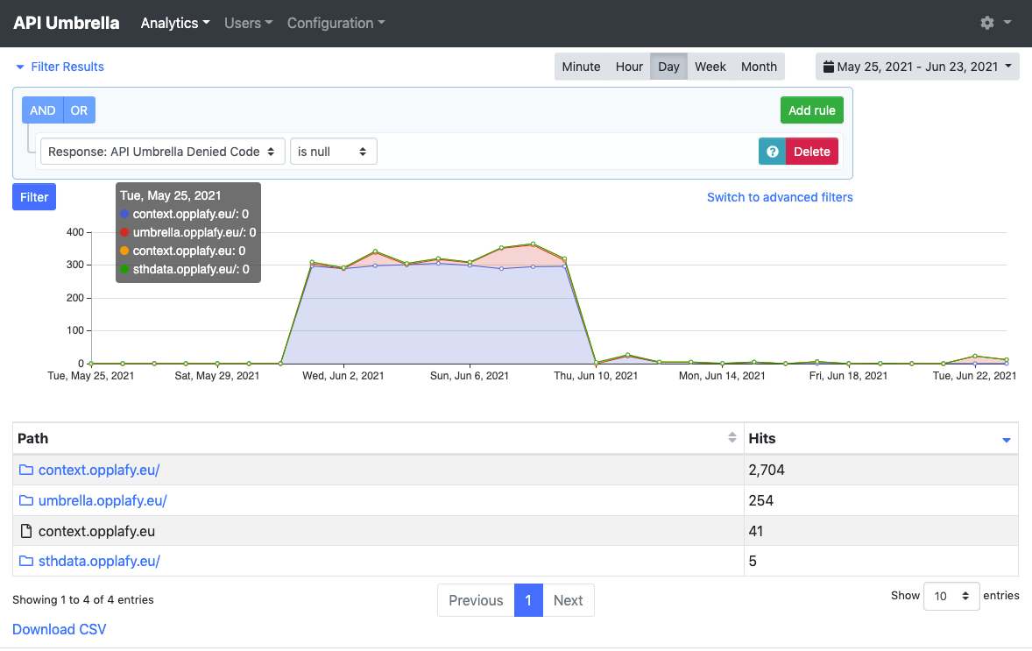
API Umbrella
All requests made to the different services secured with API Umbrella are logged into an elasticsearch instance.
Analytics about access can be retrieved and filtered by period and content
API Umbrella provides 3 tools for analytics
API Drilldown: Requests per service and path
By User: Requests per user
By Location: Requests per location

Slide 7
API Umbrella
Álvaro Arranz
Co-founder and CEO
FICODES
aarranz@ficodes.com

Slide 8
Architecture
Participant 1
Participant 2
Portal
Portal
Context Broker
PEP/ PDP
PEP/ PDP
Context Broker
IDP
AR
AR
IDP
Trust provider

Slide 9
Architecture
Each organization has their own infrastructure
Context Broker + Keyrock + API Umbrella
Trust among participants is achived by the trust provider
Each participant has a unique participant ID and a signed certificate
Each participant only deals with its own users, and the permissions of other participant organizations

Slide 10
Login with external IDP
Participant 1
Participant 2
Portal
Portal
Context Broker
PEP/ PDP
PEP/ PDP
Context Broker
IDP
AR
AR
IDP
Trust provider

Slide 11
Login with external IDP (step 1)
> Headers
{
"alg": "RS256",
"typ": "JWT",
"x5c": [ // Complete certificate chain of the party
"MIIEhjCC….Zy9w==",
...
]
}
> Payload
{
"jti": "99ab5bca41bb45b78d242a46f0157b7d", // Unique JWT ID
"iss": "EU.EORI.NLMARKETPLA",
"sub": "EU.EORI.NLMARKETPLA",
"aud": "EU.EORI.NLHAPPYPETS", // ID (EORI) of the IDP to be accessed
"iat": "1540827435",
"nbf": "1540827435",
"exp": "1540827435", // 30 seconds after iat
"response_type": "code",
"client_id": "EU.EORI.NLMARKETPLA",
"scope": "openid iSHARE profile email",
"redirect_uri": "https://www.marketplace.com/openid_connect1.0/return",
"state": "af0ifjsldkj",
"nonce": "c428224ca5a",
"acr_values": "urn:http://eidas.europa.eu/LoA/NotNotified/high",
"language": "en"
}
Participant 1 portal generates a JWT signed with its certificate
The token will include its identity as sub and the identity of accessed participant (participant 2) as aud

Slide 12
Login with external IDP (step 2)
Participant 1 sends the JWT to /authorize endpoint of participant 2 IDP including it in request parameter
Participant 2 IDP validates the JWT and its signature, then call the trust provider to check whether participant 1 is a trusted party
If everything goes well, participant 2 IDP answers participant 1 with the URL for user login in Location header.
> Content-Type: application/x-www-form-urlencoded
POST https://idp-pdc.i4trust.fiware.io/authorize
response_type=code&
client_id=EU.EORI.NLMARKETPLA&
scope=iSHARE openid&
request=eyJ0eXA…YkNKOQ

Slide 13
Login with external IDP (step 3)
Participant 1 redirects user browser to the URL provided by participant 2, so the user can sign in using participant 2 IDP
Participant 2 IDP will return an authorization code using the provided redirect URI.
< Location: https://marketplace.i4trust.fiware.io/openid_connect1.0/return?
code=Dmn-TbSj7OcKl5ym1j5xZsgkabzVP8dMugC81nzmeW4&
state=ZqVQm4zHaEDyBhzpm1ZRH7fsxy703lq2

Slide 14
Login with external IDP (step 4)
Participant 1 calls the /token endpoint of participant 2 IDP to get an access token for the user
JWT generated in step 1 is included in client_assertion parameter
Authorization code given in step 3 is included in code parameter.
> Content-Type: application/x-www-form-urlencoded
POST https://idp-pdc.i4trust.fiware.io/token
grant_type=authorization_code&
client_id=EU.EORI.NLMARKETPLA&
client_assertion_type=urn:ietf:params:oauth:client-assertion-type:jwt-bearer&
client_assertion=eyJ0eXA…YkNKOQ&
redirect_uri=https://marketplace.i4trust.fiware.io/openid_connect1.0/return&
code=Dmn-TbSj7OcKl5ym1j5xZsgkabzVP8dMugC81nzmeW4

Slide 15
Login with external IDP (step 5)
< Content-Type: application/json
< Cache-Control: no-store
< Pragma: no-cache
{
"id_token": "eyJhb...V2jA",
"access_token": "aW2ys...LIOw",
"expires_in": 3600,
"token_type": "Bearer"
}
Decoded id_token parameter
{
"iss": "EU.EORI.NLPACKETDEL",
"sub": "419404e1-07ce-4d80-9e8a-eca94vde0003de",
"aud": "EU.EORI.NLMARKETPLA",
"jti": "378a47c4-2822-4ca5-a49a-7e5a1cc7ea59",
"iat": 1504683445,
"exp": 1504683475,
"auth_time": 1504683435,
"nonce": "c428224ca5a",
"acr": "urn:http://eidas.europa.eu/LoA/NotNotified/low",
"azp": "EU.EORI.NLMARKETPLA",
}
Participant 2 will return an access token that can be used to access services as well as an OIDC ID token with user information.
Token can be used also to access user info endpoint of participant 2

Slide 16
Accessing data
Participant 1
Participant 2
Portal
Portal
PEP/ PDP
PEP/ PDP
Context Broker
Context Broker
IDP
AR
AR
IDP
Trust provider

Slide 17
Accessing data (step 1)
> Authorization: Bearer IIeD...NIQ // Bearer JWT
> Content-Type: application/json
PATCH https://umbrella.i4trust.fiware.io/ngsi-ld/v1/entities/urn:ngsi-ld:DELIVERYORDER:001/attrs/pta
> Payload
{
"value": "<new PTA>",
"type": "Property"
}
Decoded Bearer JWT:
{
"iss": "EU.EORI.NLHAPPYPETS",
"sub": "419404e1-07ce-4d80-9e8a-eca94vde0003de",
"jti": "d8a7fd7465754a4a9117ee28f5b7fb60",
"iat": 1591966224,
"exp": 1591966254,
"aud": "EU.EORI.NLHAPPYPETS",
"delegationEvidence": {
"notBefore": 1541058939,
"notOnOrAfter": 2147483647,
"policyIssuer": "EU.EORI.NLHAPPYPETS",
"target": {
"accessSubject": "419404e1-07ce-4d80-9e8a-eca94vde0003de" // ID of customer
},
"policySets": [
…
User from participant 2 makes a data request to the participant 1 Context Broker throuht the PEP proxy
The request includes a JWT issued by participant 2 IDP and user access permissions granted by participant 2

Slide 18
Accessing data (step 2)
> Authorization: Bearer IIeD...NIQ // Bearer JWT
> Content-Type: application/json
PATCH https://umbrella.i4trust.fiware.io/ngsi-ld/v1/entities/urn:ngsi-ld:DELIVERYORDER:001/attrs/pta
> Payload
{
"value": "<new PTA>",
"type": "Property"
}
Decoded Bearer JWT:
{
"iss": "EU.EORI.NLHAPPYPETS",
"sub": "419404e1-07ce-4d80-9e8a-eca94vde0003de",
"jti": "d8a7fd7465754a4a9117ee28f5b7fb60",
"iat": 1591966224,
"exp": 1591966254,
"aud": "EU.EORI.NLHAPPYPETS",
"delegationEvidence": {
"notBefore": 1541058939,
"notOnOrAfter": 2147483647,
"policyIssuer": "EU.EORI.NLHAPPYPETS",
"target": {
"accessSubject": "419404e1-07ce-4d80-9e8a-eca94vde0003de" // ID of customer
},
"policySets": [
…
PEP proxy from participant 1 validates the JWT signature and trust of the participant 2.

Slide 19
Accessing data (step 3)
> Authorization: Bearer IIeD...NIQ // Bearer JWT
> Content-Type: application/json
PATCH https://umbrella.i4trust.fiware.io/ngsi-ld/v1/entities/urn:ngsi-ld:DELIVERYORDER:001/attrs/pta
> Payload
{
"value": "<new PTA>",
"type": "Property"
}
Decoded Bearer JWT:
{
"iss": "EU.EORI.NLHAPPYPETS",
"sub": "419404e1-07ce-4d80-9e8a-eca94vde0003de",
"jti": "d8a7fd7465754a4a9117ee28f5b7fb60",
"iat": 1591966224,
"exp": 1591966254,
"aud": "EU.EORI.NLHAPPYPETS",
"delegationEvidence": {
"notBefore": 1541058939,
"notOnOrAfter": 2147483647,
"policyIssuer": "EU.EORI.NLHAPPYPETS",
"target": {
"accessSubject": "419404e1-07ce-4d80-9e8a-eca94vde0003de" // ID of customer
},
"policySets": [
…
PEP proxy checks whether the user has been authorized by participant 2 to access to the specified data using user permissions embedded in the JWT
PEP proxy checks whether the participant 2 is authorized to grant its users access to the specified data. PEP proxy uses its Authorization Registry for such validation
If everything is correct, data is returned to the user

